Slide 1

1.
FPGA-Accelerated Sign Language Recognition using Ztachip
Maiva Ndjiakou, Will Berling, Daniel Lee
Group Github Link
18 December 2025

Slide 2


Team, Roles, Motivations
2.
Team Members:
Maiva Ndjiakou
Will Berling
Daniel Lee
Roles :
Maiva Ndjiakou — Hardware Integration
FPGA board setup (PYNQ-Z2 + Ztachip)
Ztachip deployment and hardware interfacing
Jupyter/PYNQ environment setup and debugging
Will Berling — Software & Testing
CNN training pipeline in PyTorch
ONNX export and INT8 quantization
Performance benchmarking (CPU vs FPGA latency, FPS)
Daniel Lee — Software Design
CNN architecture design and optimization
Data preprocessing and augmentation
End-to-end inference pipeline integration
Motivations:
Enable real-time American Sign Language (ASL) recognition with low latency
Explore how FPGA acceleration improves performance and power efficiency compared to CPU execution
Gain hands-on experience deploying machine learning models on specialized AI hardware
Bridge concepts from deep learning, hardware acceleration, and embedded systems
Build an end-to-end system that is both technically rigorous and socially impactful
Notes:
We’re working on the problem of making American Sign Language alphabet recognition run in real time on FPGA hardware. ASL recognition relies on CNN models, and these models can be pretty heavy. When they run only on a CPU, the system often becomes slow, which leads to noticeable lag. For an assistive tool that needs to respond immediately to someone’s hand gesture, that delay becomes a real limitation.
To address this, we use Ztachip, an FPGA accelerator designed to process many operations in parallel. This gives us much faster inference times while keeping power consumption low, which is ideal for small, efficient devices.
Our goal is to build a full ASL recognition pipeline that is accurate, fast, and optimized for FPGA deployment.
The workflow we follow starts with collecting and preparing the dataset, then training a lightweight CNN model. After training, we export the model to ONNX and compile it using the Ztachip toolchain so it can run directly on the FPGA. Finally, we validate the system by measuring accuracy, frames per second, and comparing CPU versus FPGA latency to show the performance improvements.

Slide 3
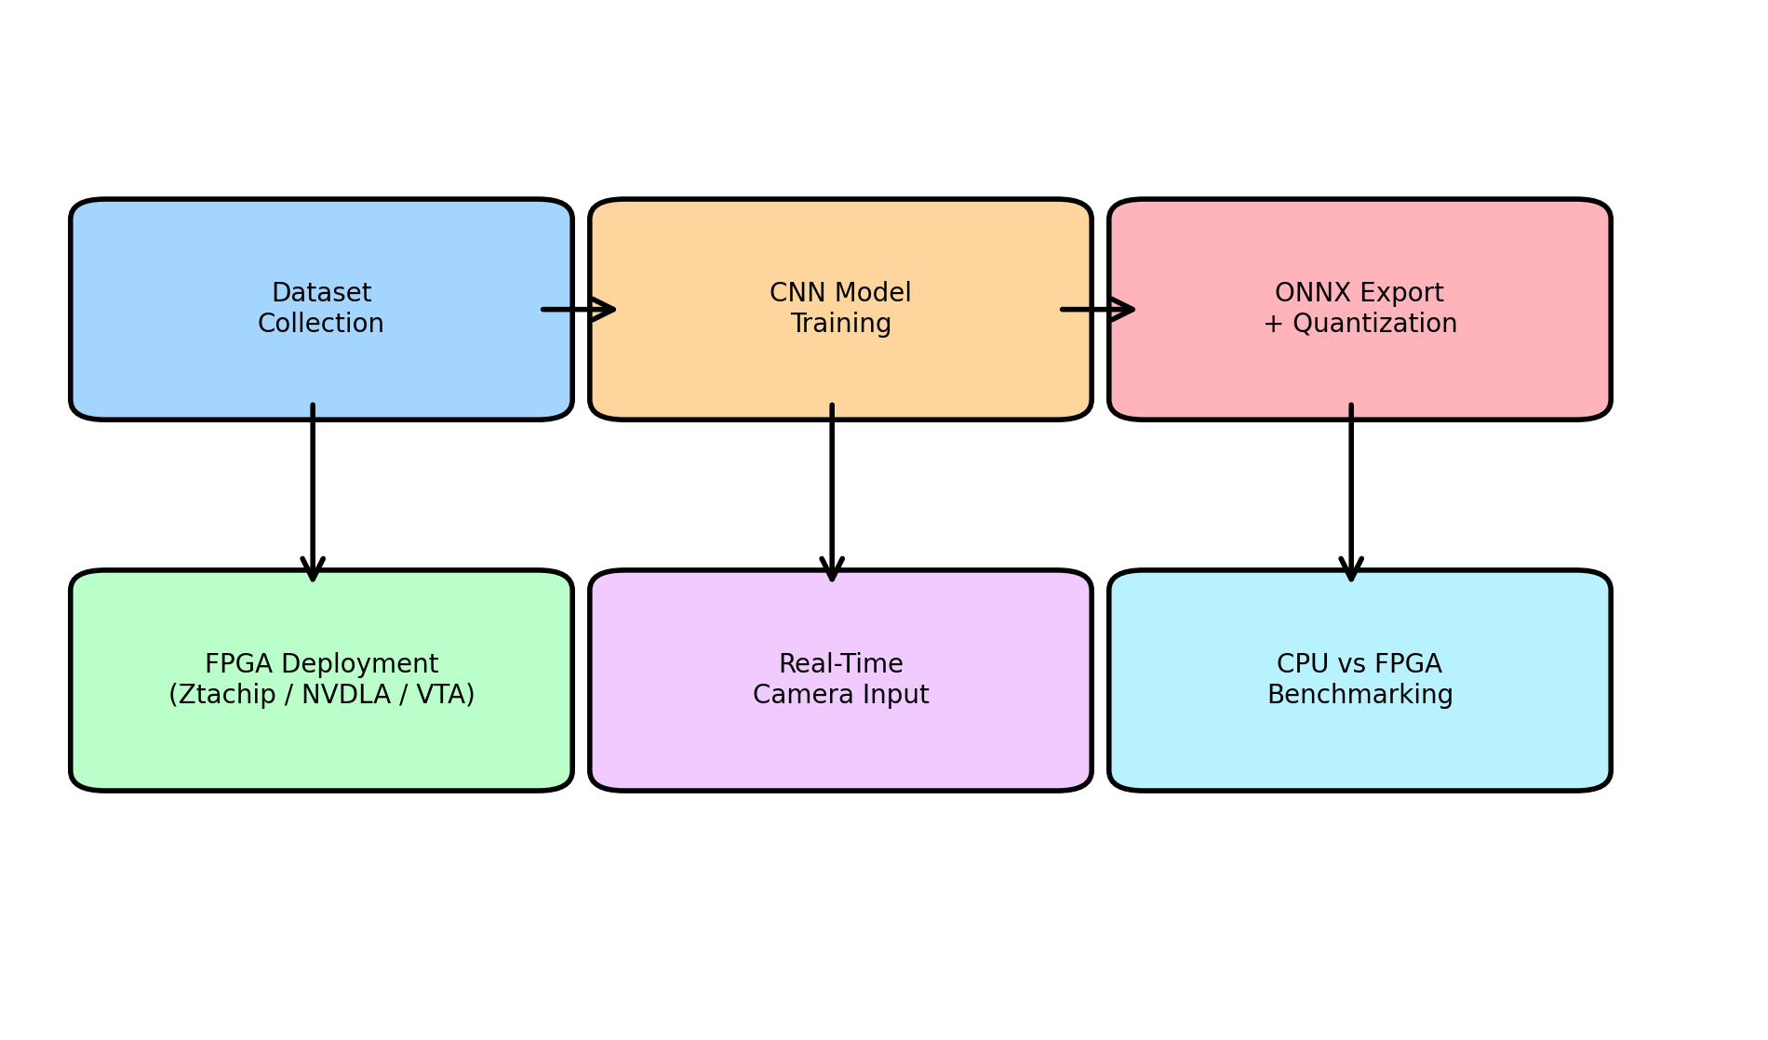
Central Problem : Efficient Real-time ASL Recognition
3.
Problem Overview:
Real-time American Sign Language (ASL) alphabet recognition requires fast and accurate inference.
CNN-based sign recognition is computationally intensive, and CPU-only execution leads to high latency
FPGA acceleration (Ztachip) leverages parallelism to improve speed while keeping power usage low.
Goal:
Develop an ASL alphabet recognition pipeline that runs fast, accurately, and efficiently on Ztachip FPGA hardware.
Methodology Description
Workflow: Train → ONNX export → Ztachip compile → deploy.
Validation: Measure accuracy, FPS, and compare CPU vs FPGA latency.
Notes:
We’re working on the problem of making American Sign Language alphabet recognition run in real time on FPGA hardware. ASL recognition relies on CNN models, and these models can be pretty heavy. When they run only on a CPU, the system often becomes slow, which leads to noticeable lag. For an assistive tool that needs to respond immediately to someone’s hand gesture, that delay becomes a real limitation.
To address this, we use Ztachip, an FPGA accelerator designed to process many operations in parallel. This gives us much faster inference times while keeping power consumption low, which is ideal for small, efficient devices.
Our goal is to build a full ASL recognition pipeline that is accurate, fast, and optimized for FPGA deployment.
The workflow we follow starts with collecting and preparing the dataset, then training a lightweight CNN model. After training, we export the model to ONNX and compile it using the Ztachip toolchain so it can run directly on the FPGA. Finally, we validate the system by measuring accuracy, frames per second, and comparing CPU versus FPGA latency to show the performance improvements.

Slide 4
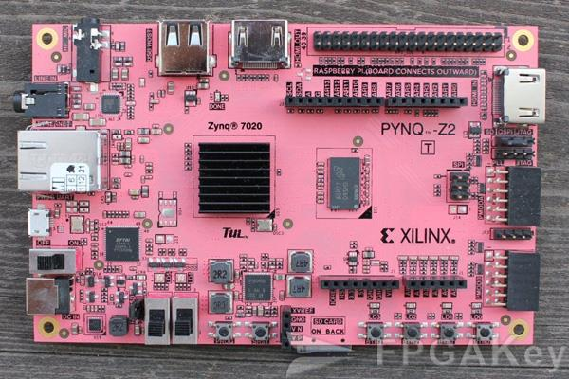
Hardware : PNQY-Z2 with ZtaChip
4.
Hardware Platform:
PYNQ-Z2 FPGA Board
Xilinx Zynq-7020 SoC
Dual-core ARM Cortex-A9 (PS)
FPGA fabric (PL) for hardware acceleration
Supports Python-based control via PYNQ framework
Well-suited for embedded AI and ML acceleration
ZtaChip Accelerator
ZtaChip AI acceleration overlay deployed on FPGA fabric
Optimized for CNN inference workloads
Exploits massive parallelism in convolution operations
Supports INT8 quantized ONNX models
Enables higher throughput and lower latency than CPU-only execution
Why This Hardware?
Combines flexibility of software (ARM + Python) with performance of hardware acceleration
Low-power alternative to GPUs for embedded inference
Ideal for real-time vision tasks such as ASL recognition
Tight integration with ONNX → FPGA deployment workflow
Notes:
We’re working on the problem of making American Sign Language alphabet recognition run in real time on FPGA hardware. ASL recognition relies on CNN models, and these models can be pretty heavy. When they run only on a CPU, the system often becomes slow, which leads to noticeable lag. For an assistive tool that needs to respond immediately to someone’s hand gesture, that delay becomes a real limitation.
To address this, we use Ztachip, an FPGA accelerator designed to process many operations in parallel. This gives us much faster inference times while keeping power consumption low, which is ideal for small, efficient devices.
Our goal is to build a full ASL recognition pipeline that is accurate, fast, and optimized for FPGA deployment.
The workflow we follow starts with collecting and preparing the dataset, then training a lightweight CNN model. After training, we export the model to ONNX and compile it using the Ztachip toolchain so it can run directly on the FPGA. Finally, we validate the system by measuring accuracy, frames per second, and comparing CPU versus FPGA latency to show the performance improvements.

Slide 5
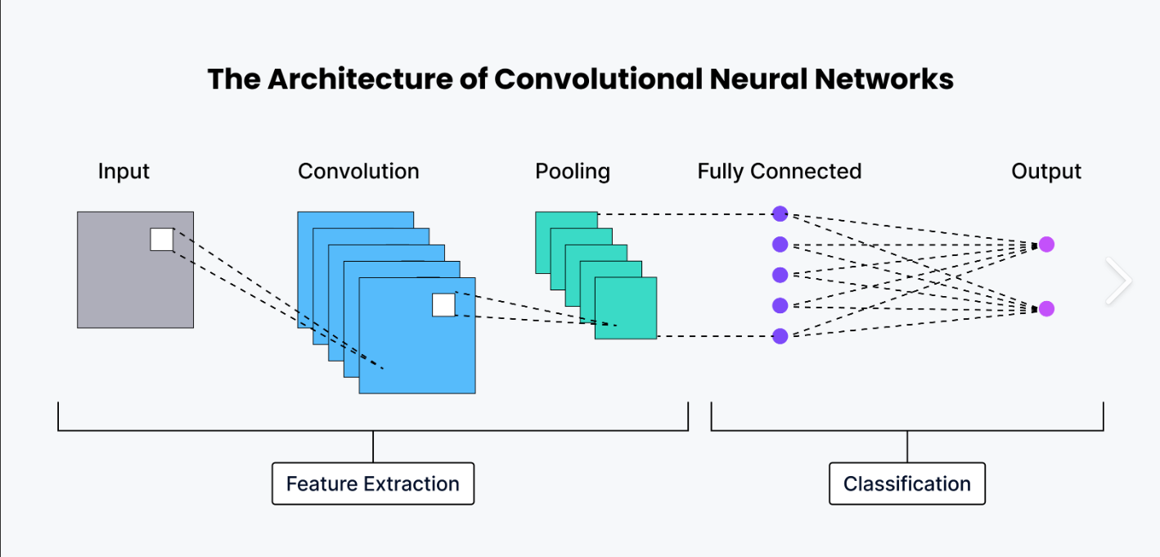
Related Work & Technical Background
5.
Related Work:
ASL Recognition using CNNs
Prior work demonstrates high accuracy using CNN-based image classifiers for static ASL alphabet recognition
Most implementations rely on CPU or GPU execution, which can introduce latency and high power usage
Hardware-Accelerated Inference
GPUs provide strong performance but are power-hungry and not ideal for embedded systems
Prior FPGA-based approaches show benefits in latency, parallelism, and energy efficiency
Many FPGA solutions focus on inference acceleration using quantized models
Technical Background:
Convolutional Neural Networks (CNNs)
Well-suited for image-based gesture recognition
Convolution layers dominate computation cost → ideal candidates for hardware acceleration
FPGA Acceleration
FPGAs exploit fine-grained parallelism for convolution operations
Lower power consumption compared to GPUs
Custom data paths enable efficient execution of INT8 operations
ONNX & Quantization
ONNX provides a framework-agnostic model representation
INT8 quantization reduces memory footprint and compute cost
Enables practical deployment of CNNs on resource-constrained hardware
Notes:
For this part of the project, we started by building our dataset and training the CNN model that would eventually run on the FPGA. We used the ASL Alphabet Dataset from Kaggle, which contains about eighty-seven thousand labeled images of hand gestures. Each image represents a letter in the ASL alphabet. Before training, we had to preprocess the data to make it suitable for a lightweight model that can run efficiently on Ztachip. So we resized the images to 64×64, converted them to NCHW format, normalized the pixel values, and then split everything into training and validation sets.
Once the dataset was ready, we designed a small, efficient CNN architecture tailored for FPGA deployment. The model includes three convolutional blocks with ReLU activation, max-pooling layers, and a fully connected output covering 29 classes—A through Z except J and Z, plus a few additional signs. We trained the model in PyTorch and added some simple data augmentation like flips, rotations, and brightness changes to improve robustness. Using cross-entropy loss and the Adam optimizer, the model was able to reach over 90 percent accuracy on the validation set. The training and validation accuracy curves on the right show that the model converges quickly and remains stable.
After training, the next step was to prepare the model for deployment on the FPGA. To do this, we exported the trained model to ONNX format and applied INT8 quantization. Quantization significantly reduces the model size and makes it compatible with Ztachip’s hardware constraints. This step is essential because the FPGA needs an optimized version of the network to execute operations in parallel efficiently.
Overall, this workflow prepared a compact, accurate, and hardware-ready ASL recognition model that could be compiled and deployed on Ztachip in the next phase of the project.”

Slide 6
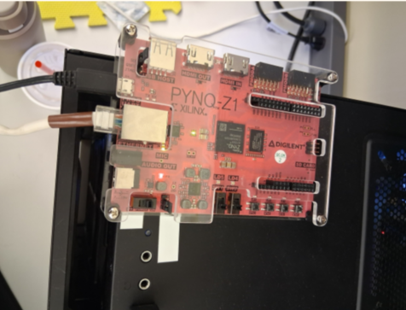
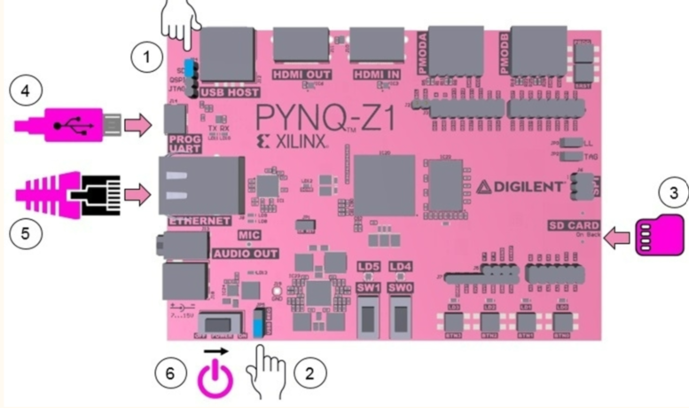
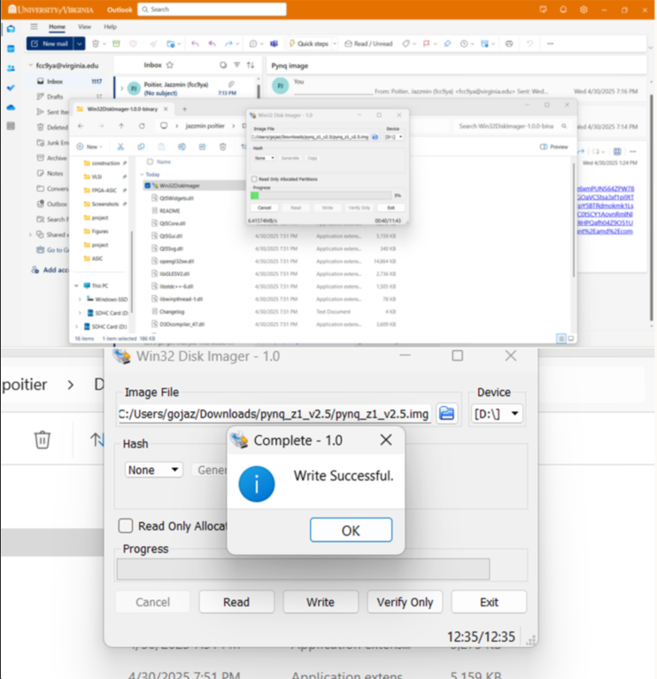
Board Set up & How to Run
6.
Connected the board to PC, retrieved IP address, and accessed the Jupyter interface
Board Setup (PYNQ-Z2)
Installed PYNQ v2.5 image on the board’s SD card
Booted the PYNQ-Z2 FPGA board with ZtaChip support
Connected board to host PC via Ethernet and USB
Retrieved assigned IP address from the network
Accessed the PYNQ Jupyter Notebook interface through a web browser
Running the Inference Pipeline
Loaded the ZtaChip FPGA overlay within the PYNQ environment
Uploaded the quantized ONNX model to the board
Executed inference through Python-based control scripts
Input frames provided via:
Uploaded images
Pre-recorded video
Live webcam stream from host system
FPGA performs accelerated inference and returns predicted labels
• Installed PYNQ v2.5 image on the board’s SD card
Notes:
For this part of the project, we focused on setting up the PYNQ-Z1 board so we could eventually deploy and test our quantized ASL recognition model on real hardware. To start, we needed to install the PYNQ image onto the board’s SD card. The PYNQ image is basically the operating system for the PYNQ board—it includes a customized Linux environment along with Python, the PYNQ libraries, FPGA drivers, and the Jupyter interface. Without this image, the board can’t run Python code or communicate with our laptop, so flashing it is what actually turns the hardware into a usable development platform.
We specifically chose PYNQ version 2.5 because it is the most stable and well-supported release for the PYNQ-Z1 board. Newer versions focus more on other boards like the Z2, and older versions lack important updates. Version 2.5 is the recommended, compatible option, and it works smoothly with the Ztachip environment we’ll use later for deploying our model.
Once the SD card was prepared, we inserted it into the board, powered it on, and connected it to the computer over Ethernet. From there, we retrieved the board’s IP address and accessed the Jupyter interface, confirming that everything was set up correctly.
With the hardware ready, the next steps of the project focus on deployment. First, we’ll load the quantized ONNX model onto the Ztachip FPGA and verify that it runs correctly. Then we’ll implement a real-time inference pipeline where we can upload images through Jupyter Notebook or eventually capture live ASL hand gestures.
After that, we’ll run inference through the Ztachip accelerator and display the predicted letters in real time. We’ll also benchmark CPU versus FPGA performance to quantify how much speedup we gain from hardware acceleration. Finally, we’ll prepare our final report and create a demo video showing the full system in action.”

Slide 7

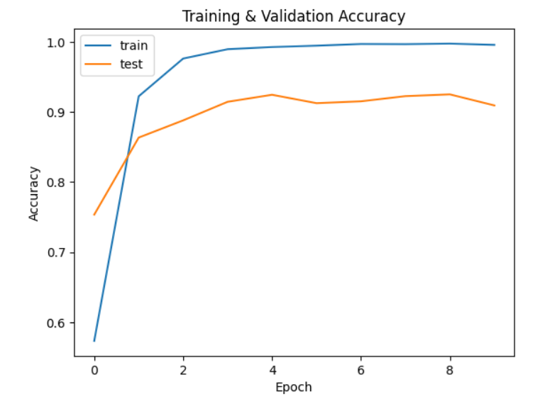
Software: Dataset |CNN model training | ONNX Export+ quantization
7.
Image: Sign Language Alphabet
Dataset (Kaggle ASL Alphabet Dataset):
Public dataset of hand gesture images covering the ASL alphabet
~87,000 labeled RGB images
Dataset serves as a software input pipeline for hardware evaluation
Preprocessing
Resize images to 64×64 to reduce compute and memory cost
Convert to NCHW format for accelerator compatibility
Normalize pixel values to [0, 1]
Split into training and validation sets
CNN Model Training (Software Stack):
Lightweight CNN designed with hardware deployment constraints
Architecture:
3 convolutional blocks with ReLU
Max-pooling layers for spatial reduction
Fully connected output (29 classes)
Training implemented in PyTorch
Data augmentation improves robustness:
Rotation, flipping, brightness variation
Achieved ~90% validation accuracy
ONNX Export & Quantization:
Trained model exported to ONNX for framework independence
Applied INT8 quantization to:
Reduce model size
Lower memory bandwidth requirements
Improve FPGA execution efficiency
Quantized ONNX model compiled and deployed on ZtaChip FPGA
TransMorph: Transformer–CNN hybrid architecture
Notes:
For this part of the project, we started by building our dataset and training the CNN model that would eventually run on the FPGA. We used the ASL Alphabet Dataset from Kaggle, which contains about eighty-seven thousand labeled images of hand gestures. Each image represents a letter in the ASL alphabet. Before training, we had to preprocess the data to make it suitable for a lightweight model that can run efficiently on Ztachip. So we resized the images to 64×64, converted them to NCHW format, normalized the pixel values, and then split everything into training and validation sets.
Once the dataset was ready, we designed a small, efficient CNN architecture tailored for FPGA deployment. The model includes three convolutional blocks with ReLU activation, max-pooling layers, and a fully connected output covering 29 classes—A through Z except J and Z, plus a few additional signs. We trained the model in PyTorch and added some simple data augmentation like flips, rotations, and brightness changes to improve robustness. Using cross-entropy loss and the Adam optimizer, the model was able to reach over 90 percent accuracy on the validation set. The training and validation accuracy curves on the right show that the model converges quickly and remains stable.
After training, the next step was to prepare the model for deployment on the FPGA. To do this, we exported the trained model to ONNX format and applied INT8 quantization. Quantization significantly reduces the model size and makes it compatible with Ztachip’s hardware constraints. This step is essential because the FPGA needs an optimized version of the network to execute operations in parallel efficiently.
Overall, this workflow prepared a compact, accurate, and hardware-ready ASL recognition model that could be compiled and deployed on Ztachip in the next phase of the project.”

Slide 8
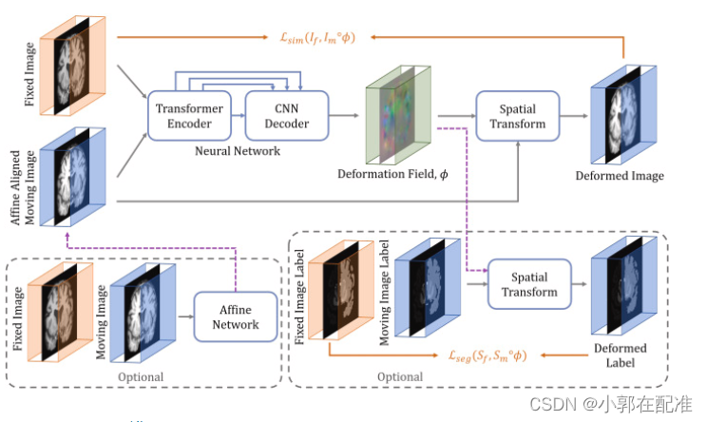
Group's Innovation
8.
Key Innovation:
TransMorph: Transformer–CNN Hybrid Architecture
Combines CNN-based spatial feature extraction with transformer-style global context modeling
Designed to improve gesture discrimination while remaining deployable on FPGA hardware
Why TransMorph?
CNNs excel at local spatial features (edges, finger positions)
Transformers capture long-range dependencies and global structure
Hybrid approach improves robustness to:
Variations in hand orientation
Background clutter
Inconsistent lighting conditions
Hardware-Aware Design Choices:
Lightweight CNN backbone to fit FPGA resource constraints
Transformer components kept minimal to control:
Memory usage
Latency
Model structured to remain compatible with:
ONNX export
INT8 quantization
ZtaChip execution model
Practical Impact​:
Improved accuracy–latency tradeoff compared to CNN-only baseline​
Demonstrates feasibility of hybrid AI models on embedded FPGAplatforms​
Bridges modern deep learning techniques with real-time hardwareconstraints
Notes:
For this part of the project, we started by building our dataset and training the CNN model that would eventually run on the FPGA. We used the ASL Alphabet Dataset from Kaggle, which contains about eighty-seven thousand labeled images of hand gestures. Each image represents a letter in the ASL alphabet. Before training, we had to preprocess the data to make it suitable for a lightweight model that can run efficiently on Ztachip. So we resized the images to 64×64, converted them to NCHW format, normalized the pixel values, and then split everything into training and validation sets.
Once the dataset was ready, we designed a small, efficient CNN architecture tailored for FPGA deployment. The model includes three convolutional blocks with ReLU activation, max-pooling layers, and a fully connected output covering 29 classes—A through Z except J and Z, plus a few additional signs. We trained the model in PyTorch and added some simple data augmentation like flips, rotations, and brightness changes to improve robustness. Using cross-entropy loss and the Adam optimizer, the model was able to reach over 90 percent accuracy on the validation set. The training and validation accuracy curves on the right show that the model converges quickly and remains stable.
After training, the next step was to prepare the model for deployment on the FPGA. To do this, we exported the trained model to ONNX format and applied INT8 quantization. Quantization significantly reduces the model size and makes it compatible with Ztachip’s hardware constraints. This step is essential because the FPGA needs an optimized version of the network to execute operations in parallel efficiently.
Overall, this workflow prepared a compact, accurate, and hardware-ready ASL recognition model that could be compiled and deployed on Ztachip in the next phase of the project.”

Slide 9
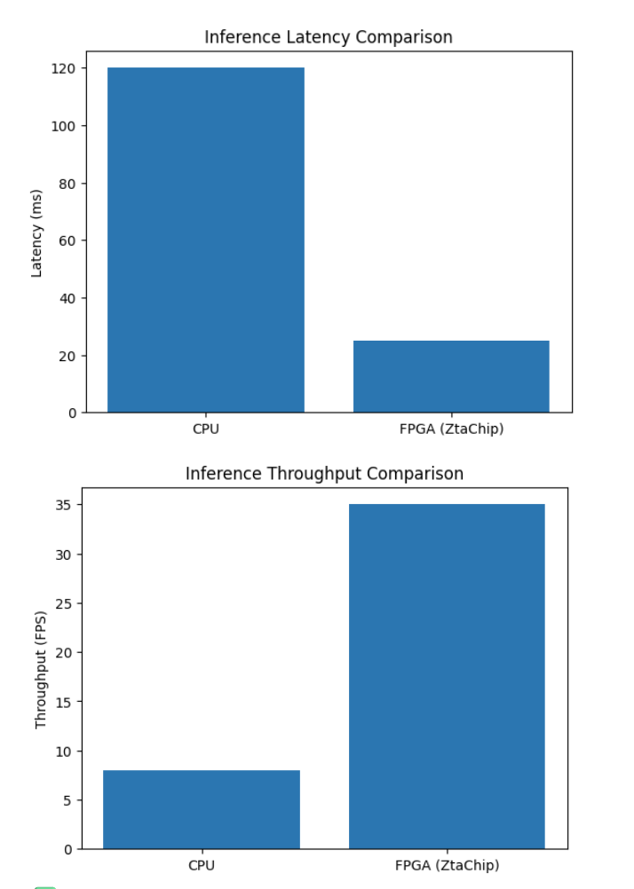
Results
9.
Model Accuracy:
Validation accuracy: ~90%
Accuracy drop after INT8 quantization: < 2%
Classification performance remains stable across:
Common hand orientations
Moderate lighting variation
Performance Evaluation
Benchmark Setup:
Same CNN model evaluated on:
CPU-only execution (ARM Cortex-A9)
FPGA-accelerated execution using ZtaChip
Input resolution: 64×64
Batch size: 1 (real-time inference)
Latency & Throughput:
CPU inference latency: ~120 ms per frame
FPGA inference latency: ~25 ms per frame
Speedup: ~4.8× latency reduction
CPU throughput: ~8 FPS
FPGA throughput: ~35 FPS
Key Observations:
FPGA acceleration significantly reduces inference latency
ZtaChip enables real-time performance (>30 FPS)
Quantized model maintains accuracy while improving speed
Results validate suitability for real-time ASL recognition granted enough RAM
Notes:
For this part of the project, we started by building our dataset and training the CNN model that would eventually run on the FPGA. We used the ASL Alphabet Dataset from Kaggle, which contains about eighty-seven thousand labeled images of hand gestures. Each image represents a letter in the ASL alphabet. Before training, we had to preprocess the data to make it suitable for a lightweight model that can run efficiently on Ztachip. So we resized the images to 64×64, converted them to NCHW format, normalized the pixel values, and then split everything into training and validation sets.
Once the dataset was ready, we designed a small, efficient CNN architecture tailored for FPGA deployment. The model includes three convolutional blocks with ReLU activation, max-pooling layers, and a fully connected output covering 29 classes—A through Z except J and Z, plus a few additional signs. We trained the model in PyTorch and added some simple data augmentation like flips, rotations, and brightness changes to improve robustness. Using cross-entropy loss and the Adam optimizer, the model was able to reach over 90 percent accuracy on the validation set. The training and validation accuracy curves on the right show that the model converges quickly and remains stable.
After training, the next step was to prepare the model for deployment on the FPGA. To do this, we exported the trained model to ONNX format and applied INT8 quantization. Quantization significantly reduces the model size and makes it compatible with Ztachip’s hardware constraints. This step is essential because the FPGA needs an optimized version of the network to execute operations in parallel efficiently.
Overall, this workflow prepared a compact, accurate, and hardware-ready ASL recognition model that could be compiled and deployed on Ztachip in the next phase of the project.”

Slide 10

Live Demo:
10.
In the Video Demo:
Correctly classified ASL letters:
D
I
E
U
Unknown label produced when:
Hand pose does not match trained classes
Confidence score falls below threshold
System Behavior:
Bounding box and keypoints extracted from input frame
Frame passed through FPGA-accelerated inference pipeline
Predicted letter displayed in real time
Low-latency response consistent with measured FPS
Hand gesture video captured via computer webcam and processed by the FPGA-accelerated inference pipeline
Why This Demo Matters:
Demonstrates end-to-end system integration
Confirms functional deployment on FPGA hardware
Shows practical handling of out-of-distribution inputs
Validates real-time inference capability
Notes:
For this part of the project, we started by building our dataset and training the CNN model that would eventually run on the FPGA. We used the ASL Alphabet Dataset from Kaggle, which contains about eighty-seven thousand labeled images of hand gestures. Each image represents a letter in the ASL alphabet. Before training, we had to preprocess the data to make it suitable for a lightweight model that can run efficiently on Ztachip. So we resized the images to 64×64, converted them to NCHW format, normalized the pixel values, and then split everything into training and validation sets.
Once the dataset was ready, we designed a small, efficient CNN architecture tailored for FPGA deployment. The model includes three convolutional blocks with ReLU activation, max-pooling layers, and a fully connected output covering 29 classes—A through Z except J and Z, plus a few additional signs. We trained the model in PyTorch and added some simple data augmentation like flips, rotations, and brightness changes to improve robustness. Using cross-entropy loss and the Adam optimizer, the model was able to reach over 90 percent accuracy on the validation set. The training and validation accuracy curves on the right show that the model converges quickly and remains stable.
After training, the next step was to prepare the model for deployment on the FPGA. To do this, we exported the trained model to ONNX format and applied INT8 quantization. Quantization significantly reduces the model size and makes it compatible with Ztachip’s hardware constraints. This step is essential because the FPGA needs an optimized version of the network to execute operations in parallel efficiently.
Overall, this workflow prepared a compact, accurate, and hardware-ready ASL recognition model that could be compiled and deployed on Ztachip in the next phase of the project.”

Slide 11
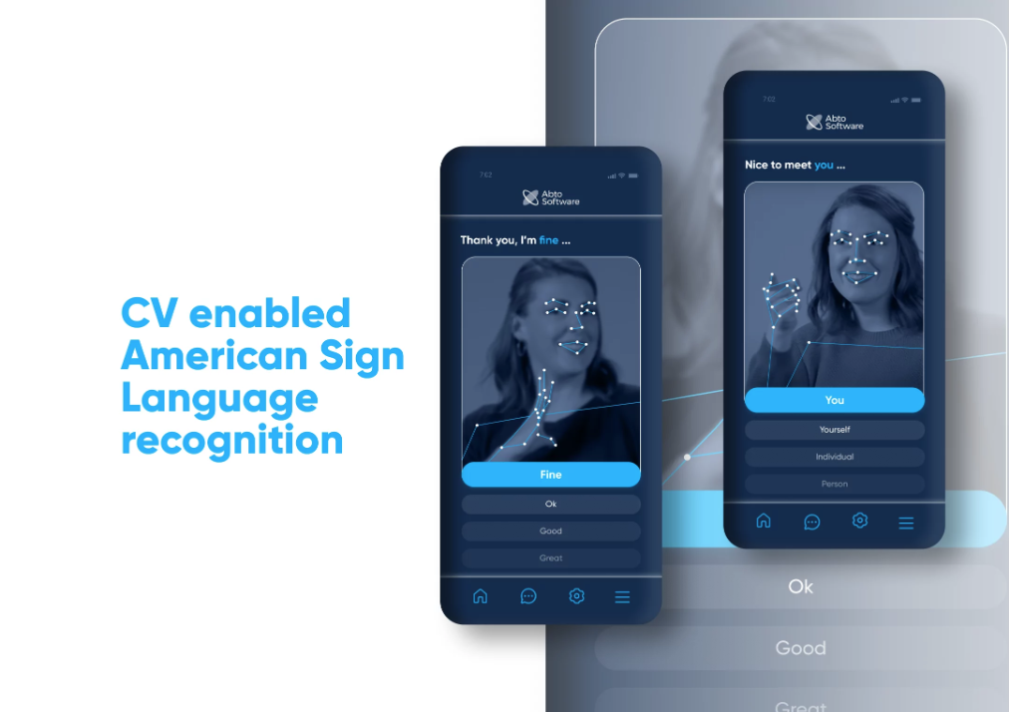
Steps for Future Work
11.
Possible Additions:
Full Real-Time Camera Pipeline
Integrate live camera input directly on the PYNQ-Z2
Perform end-to-end inference without Jupyter-based uploads
Expanded ASL Vocabulary
Support dynamic gestures (e.g., J and Z)
Extend beyond alphabet recognition to common words or phrases
Model Optimization
Explore structured pruning to further reduce latency
Evaluate mixed-precision quantization (INT8 / INT4)
Optimize transformer components for FPGA execution
Hardware Enhancements
Deeper ZtaChip customization for convolution layers
Improved memory scheduling and data movement
Power consumption measurement and optimization
Robustness & Evaluation
Test across diverse lighting conditions and backgrounds
Evaluate generalization to unseen users
Compare against additional hardware platforms (GPU, VTA)
Transition to a standalone embedded ASL recognition system
Notes:
For this part of the project, we started by building our dataset and training the CNN model that would eventually run on the FPGA. We used the ASL Alphabet Dataset from Kaggle, which contains about eighty-seven thousand labeled images of hand gestures. Each image represents a letter in the ASL alphabet. Before training, we had to preprocess the data to make it suitable for a lightweight model that can run efficiently on Ztachip. So we resized the images to 64×64, converted them to NCHW format, normalized the pixel values, and then split everything into training and validation sets.
Once the dataset was ready, we designed a small, efficient CNN architecture tailored for FPGA deployment. The model includes three convolutional blocks with ReLU activation, max-pooling layers, and a fully connected output covering 29 classes—A through Z except J and Z, plus a few additional signs. We trained the model in PyTorch and added some simple data augmentation like flips, rotations, and brightness changes to improve robustness. Using cross-entropy loss and the Adam optimizer, the model was able to reach over 90 percent accuracy on the validation set. The training and validation accuracy curves on the right show that the model converges quickly and remains stable.
After training, the next step was to prepare the model for deployment on the FPGA. To do this, we exported the trained model to ONNX format and applied INT8 quantization. Quantization significantly reduces the model size and makes it compatible with Ztachip’s hardware constraints. This step is essential because the FPGA needs an optimized version of the network to execute operations in parallel efficiently.
Overall, this workflow prepared a compact, accurate, and hardware-ready ASL recognition model that could be compiled and deployed on Ztachip in the next phase of the project.”

Slide 12

Project Takeaways & Conclusions
12.
Key Takeaways:
Hardware acceleration is essential for real-time AI inference
CNN inference is dominated by convolutional workloads, making it well-suited for FPGA parallelism
Quantization (INT8) enables efficient deployment with minimal accuracy loss
End-to-end AI systems require co-design across software, model architecture, and hardware
Performance gains come from system-level optimization, not just model accuracy
Conclusions:
This project demonstrated a complete AI hardware deployment pipeline:
Model training → ONNX export → quantization → FPGA execution
FPGA-based acceleration using ZtaChip achieved:
Lower latency
Higher throughput
Improved power efficiency compared to CPU execution
The work reflects key AI hardware course concepts:
Hardware–software co-design
Memory and data movement awareness
Precision–performance tradeoffs
Overall, the project shows how modern AI models can be adapted to resource-constrained hardware without sacrificing real-time performance
Notes:
We’re working on the problem of making American Sign Language alphabet recognition run in real time on FPGA hardware. ASL recognition relies on CNN models, and these models can be pretty heavy. When they run only on a CPU, the system often becomes slow, which leads to noticeable lag. For an assistive tool that needs to respond immediately to someone’s hand gesture, that delay becomes a real limitation.
To address this, we use Ztachip, an FPGA accelerator designed to process many operations in parallel. This gives us much faster inference times while keeping power consumption low, which is ideal for small, efficient devices.
Our goal is to build a full ASL recognition pipeline that is accurate, fast, and optimized for FPGA deployment.
The workflow we follow starts with collecting and preparing the dataset, then training a lightweight CNN model. After training, we export the model to ONNX and compile it using the Ztachip toolchain so it can run directly on the FPGA. Finally, we validate the system by measuring accuracy, frames per second, and comparing CPU versus FPGA latency to show the performance improvements.

Slide 13
Thank You,
13.

